Slide 1
LARGE EVS PARKING LOT EVS COMPARATIVE STUDY RESULTS

Slide 2
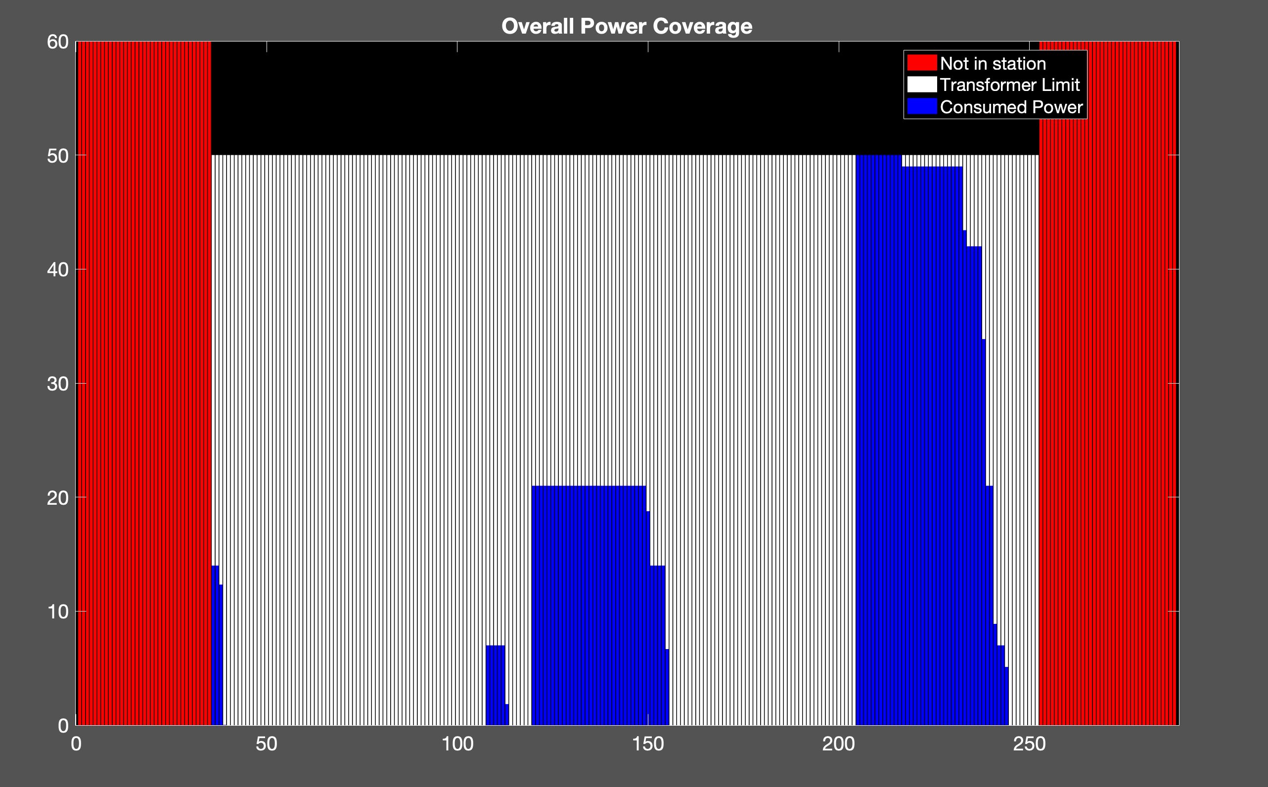
Uncoordinated Charging
10 EVs
Cost: 470.73 NT
Transformer: 50 kW

Slide 3
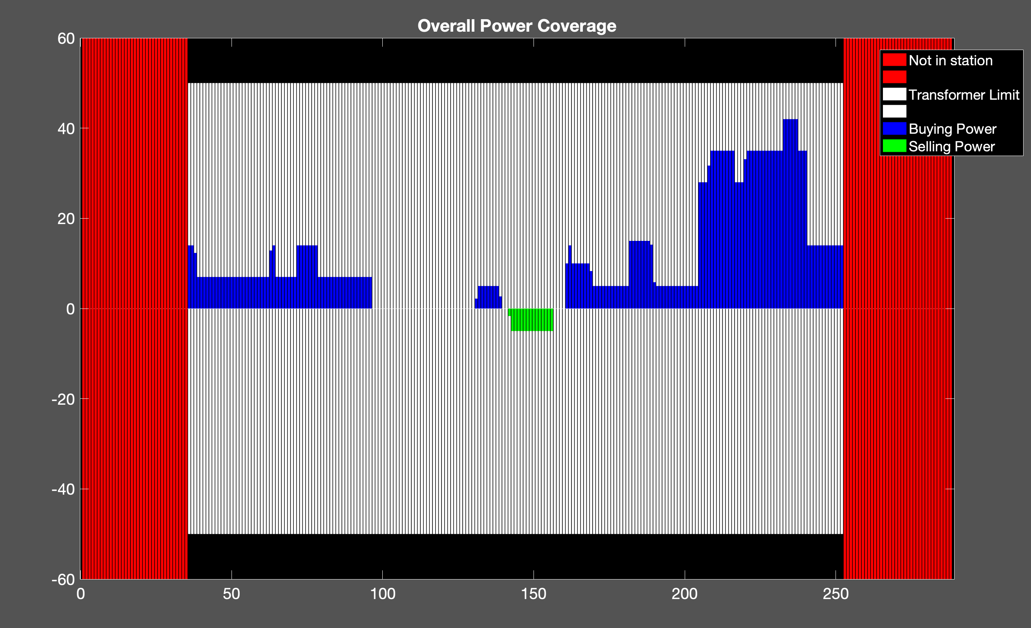
Proposed Method
10 EVs
Cost: 441.08 NT
Transformer = 50 kW

Slide 4
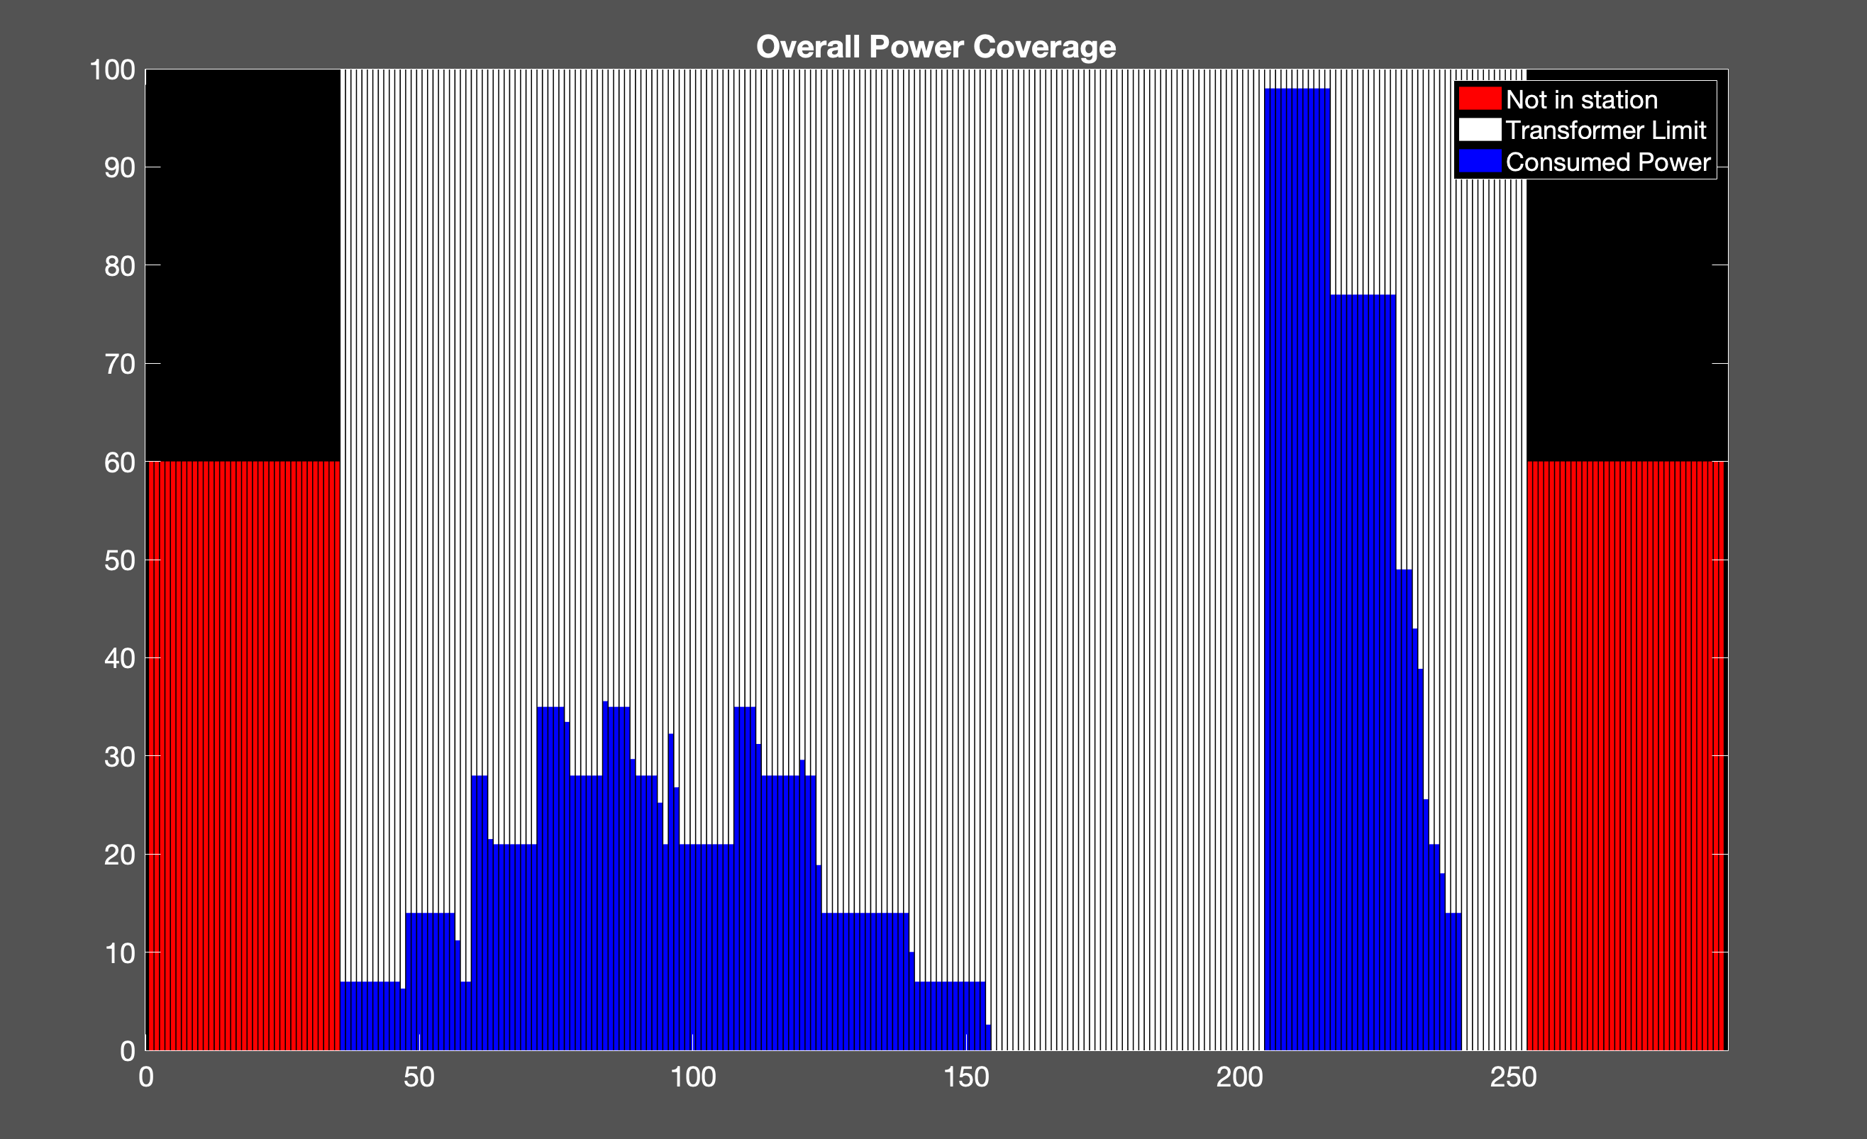
Uncoordinated Charging
20 EVs
Cost: 838.82 NT
Transformer : 100 kW

Slide 5
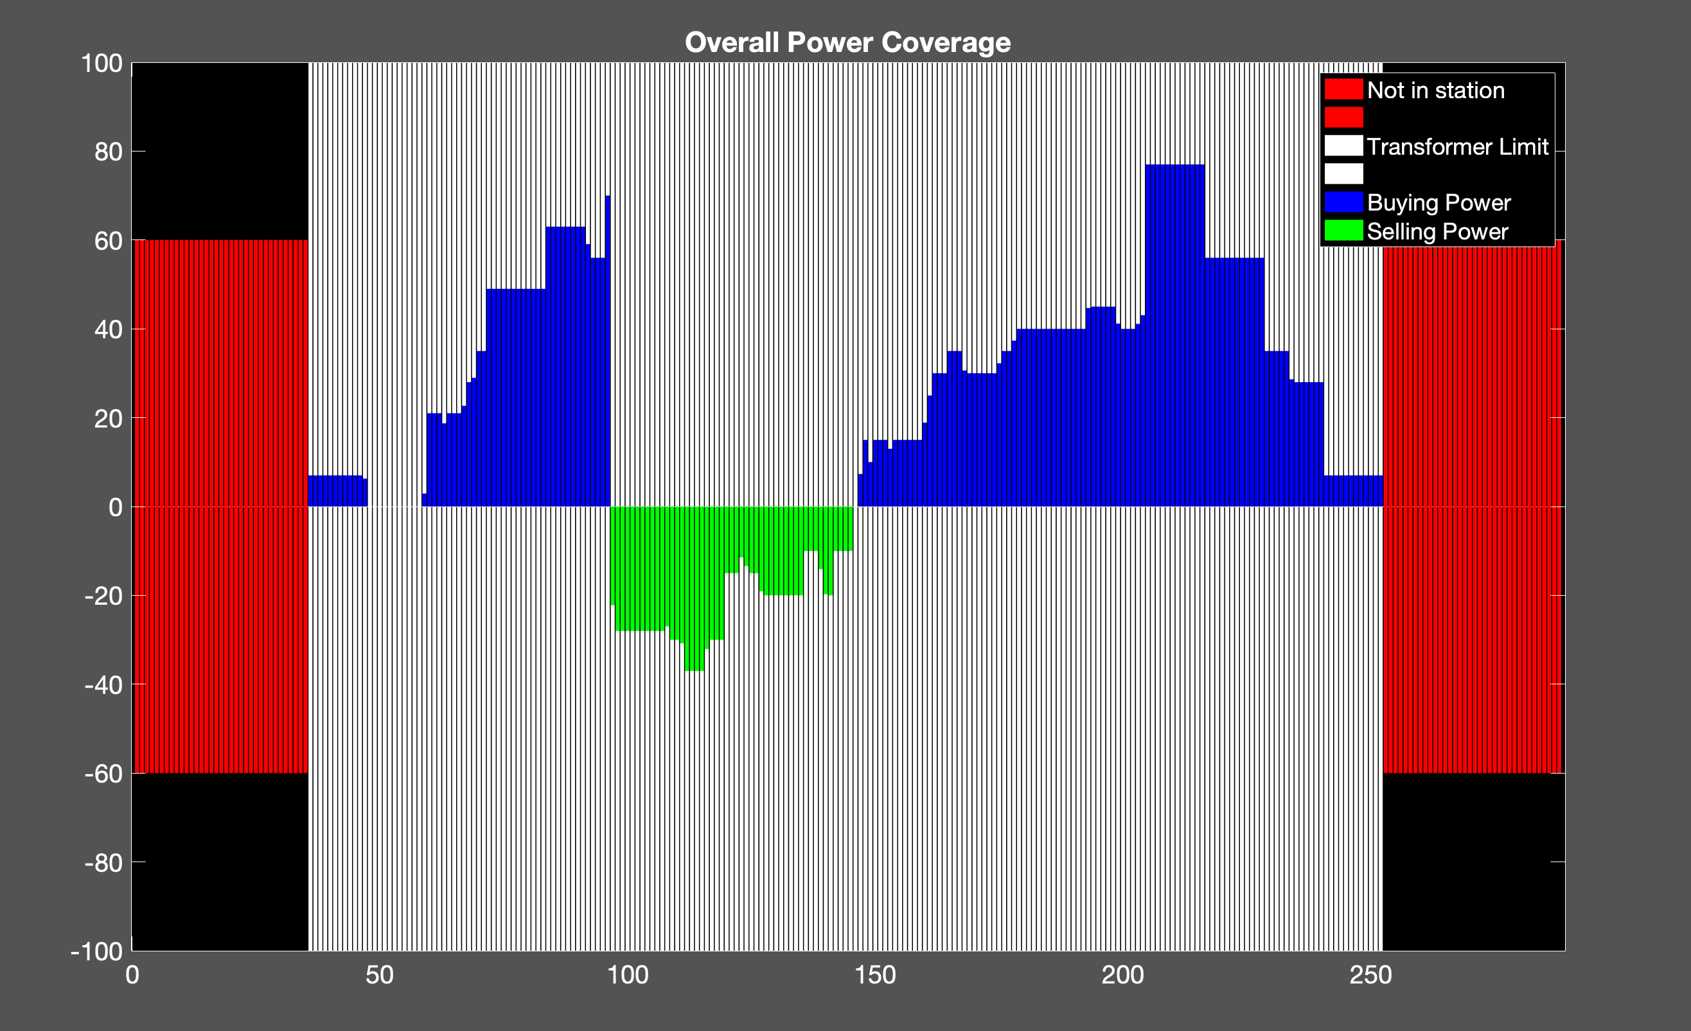
Proposed Method
20 EVs
Cost: 793.03 NT
Transformer: 100 kw

Slide 6
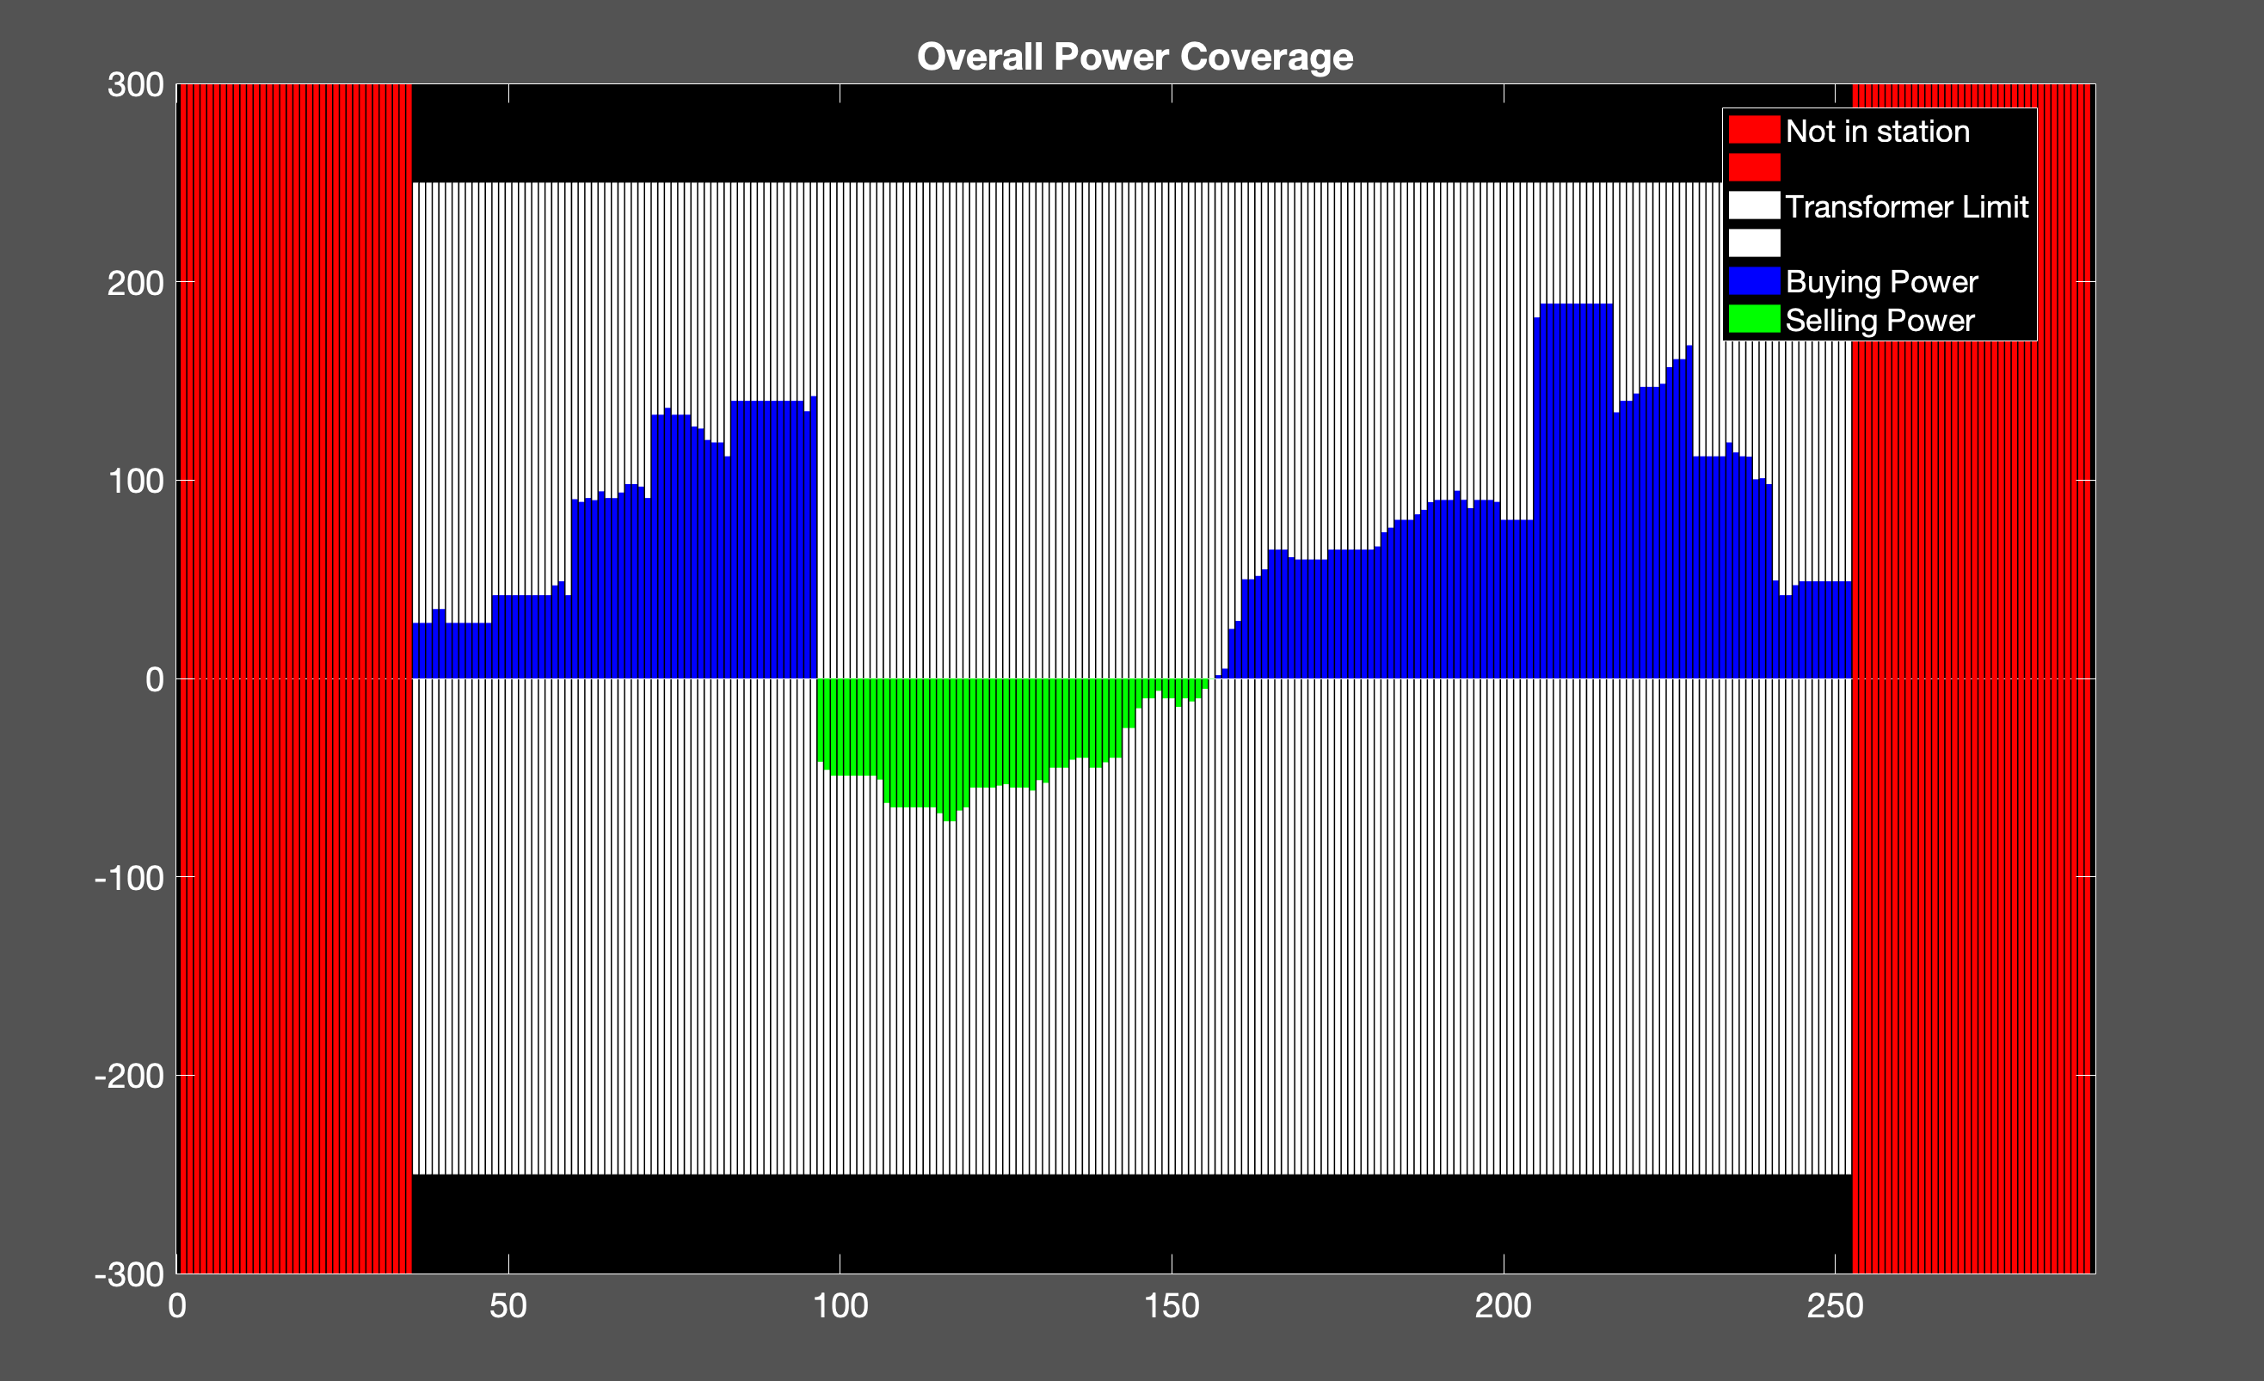
Proposed Method
50 EVs
Cost: 1.8063e+03 NT
Transformer: 250 kW

Slide 7
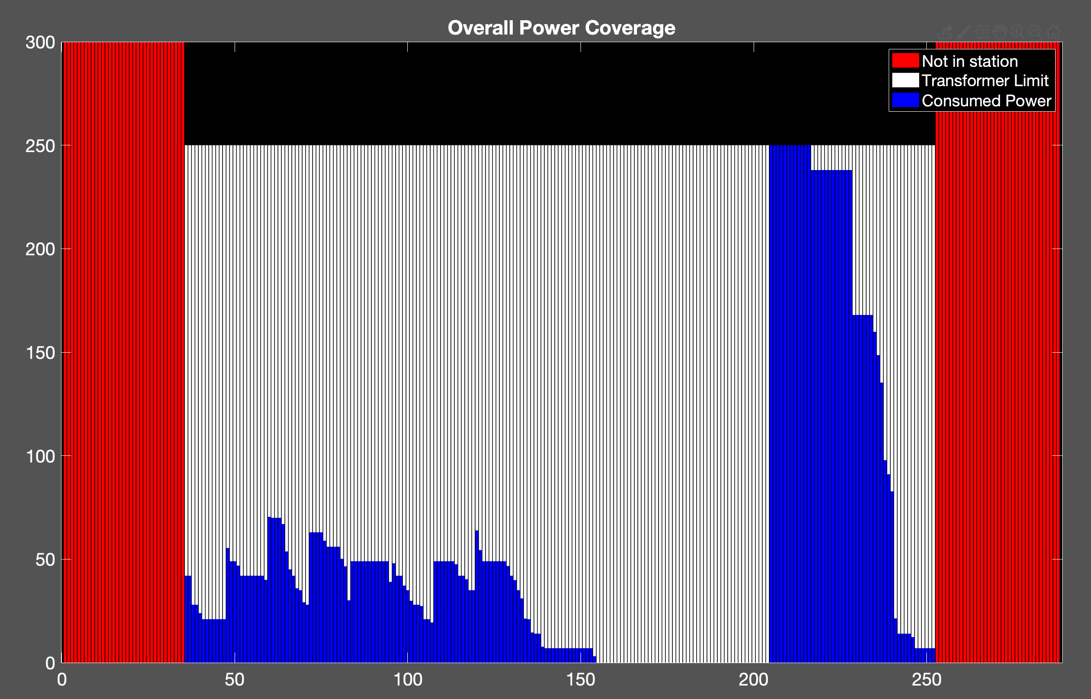
Uncoordinated Charging
50 EVs
Cost: 1.9910e+03 NT
Transformer: 250 kW

Slide 8
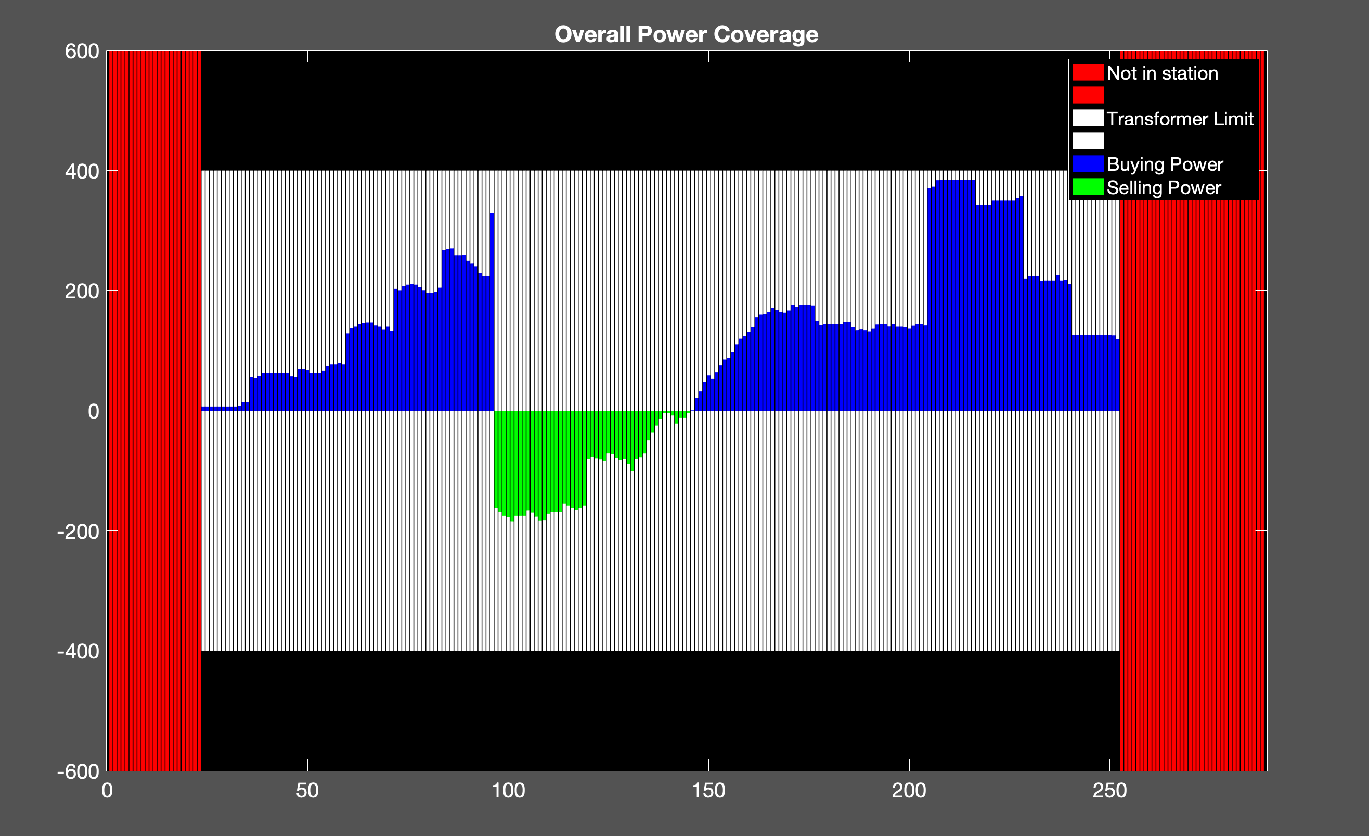
Proposed Method
100 EVs
Cost: 3.8806e+03NT
Transformer: 400kW

Slide 9
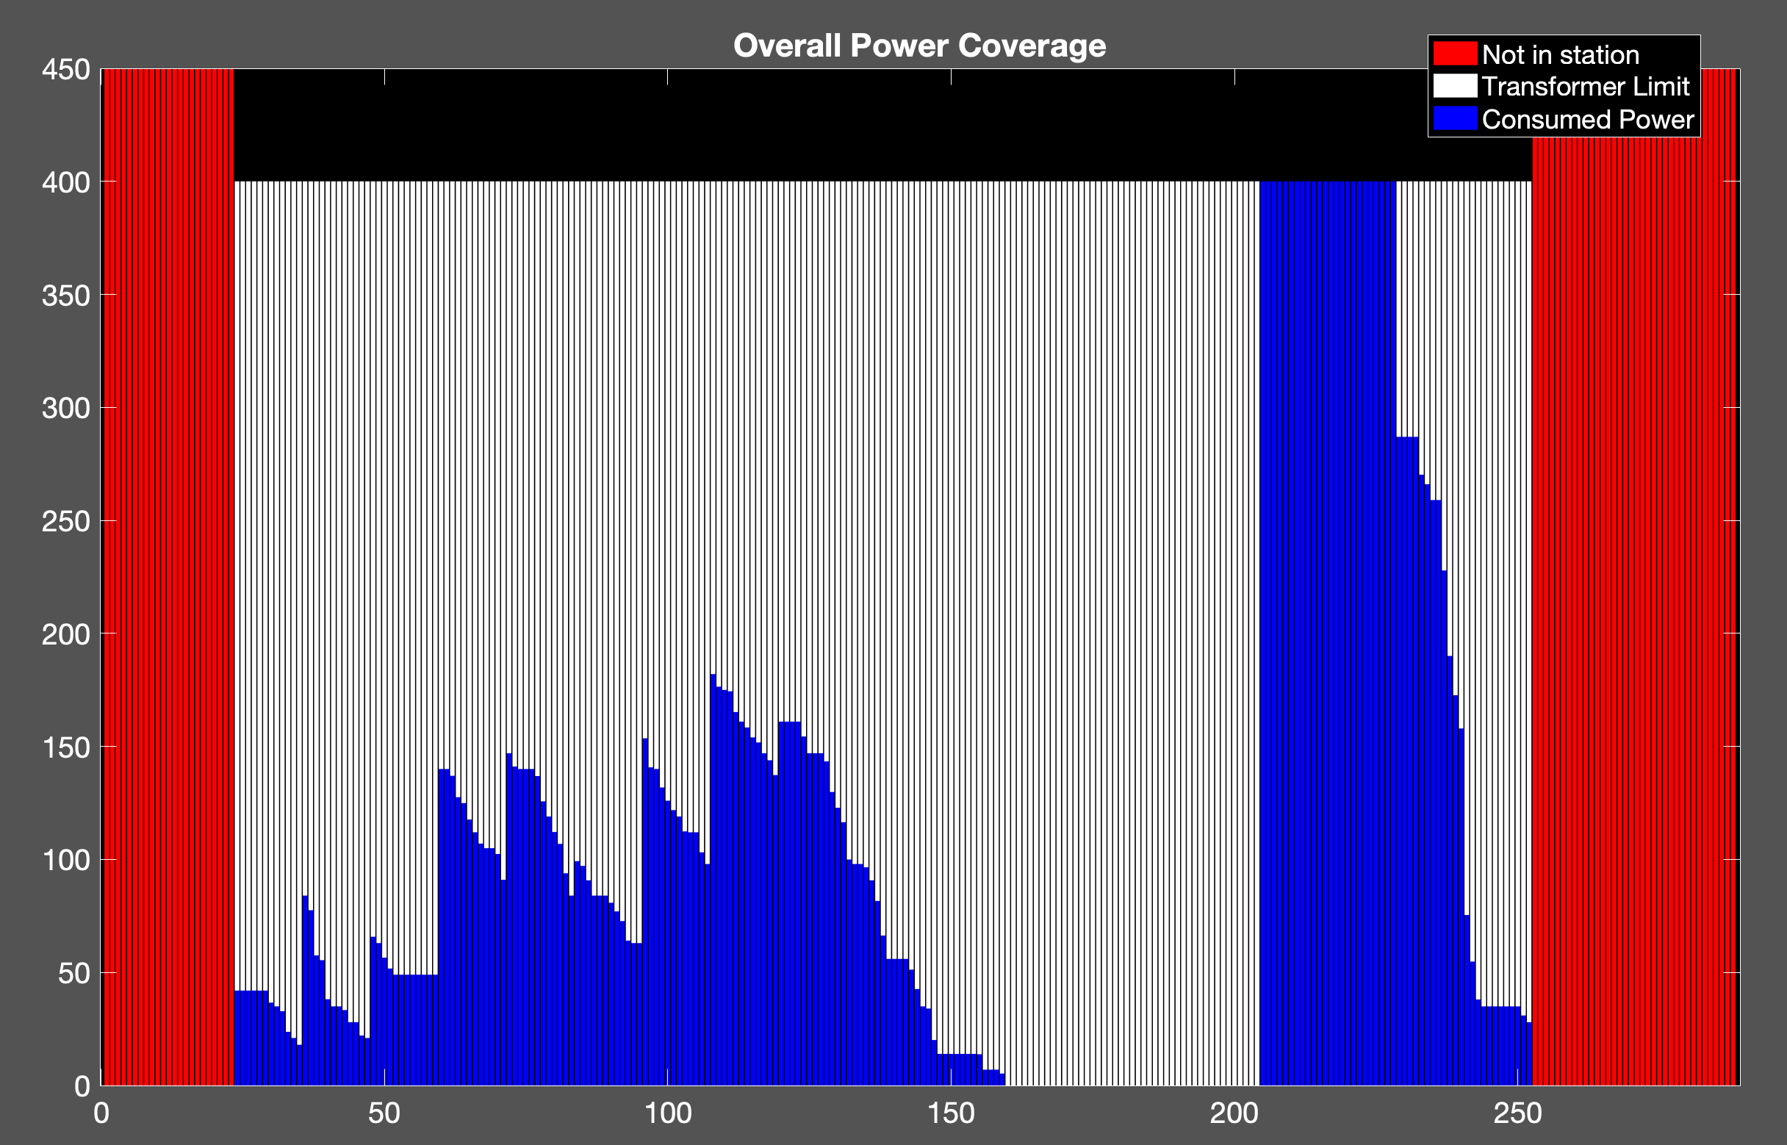
Uncoordinated Charging
100 EVs
Cost: 4.4808e+03 NT
Transformer: 400kW

Slide 10
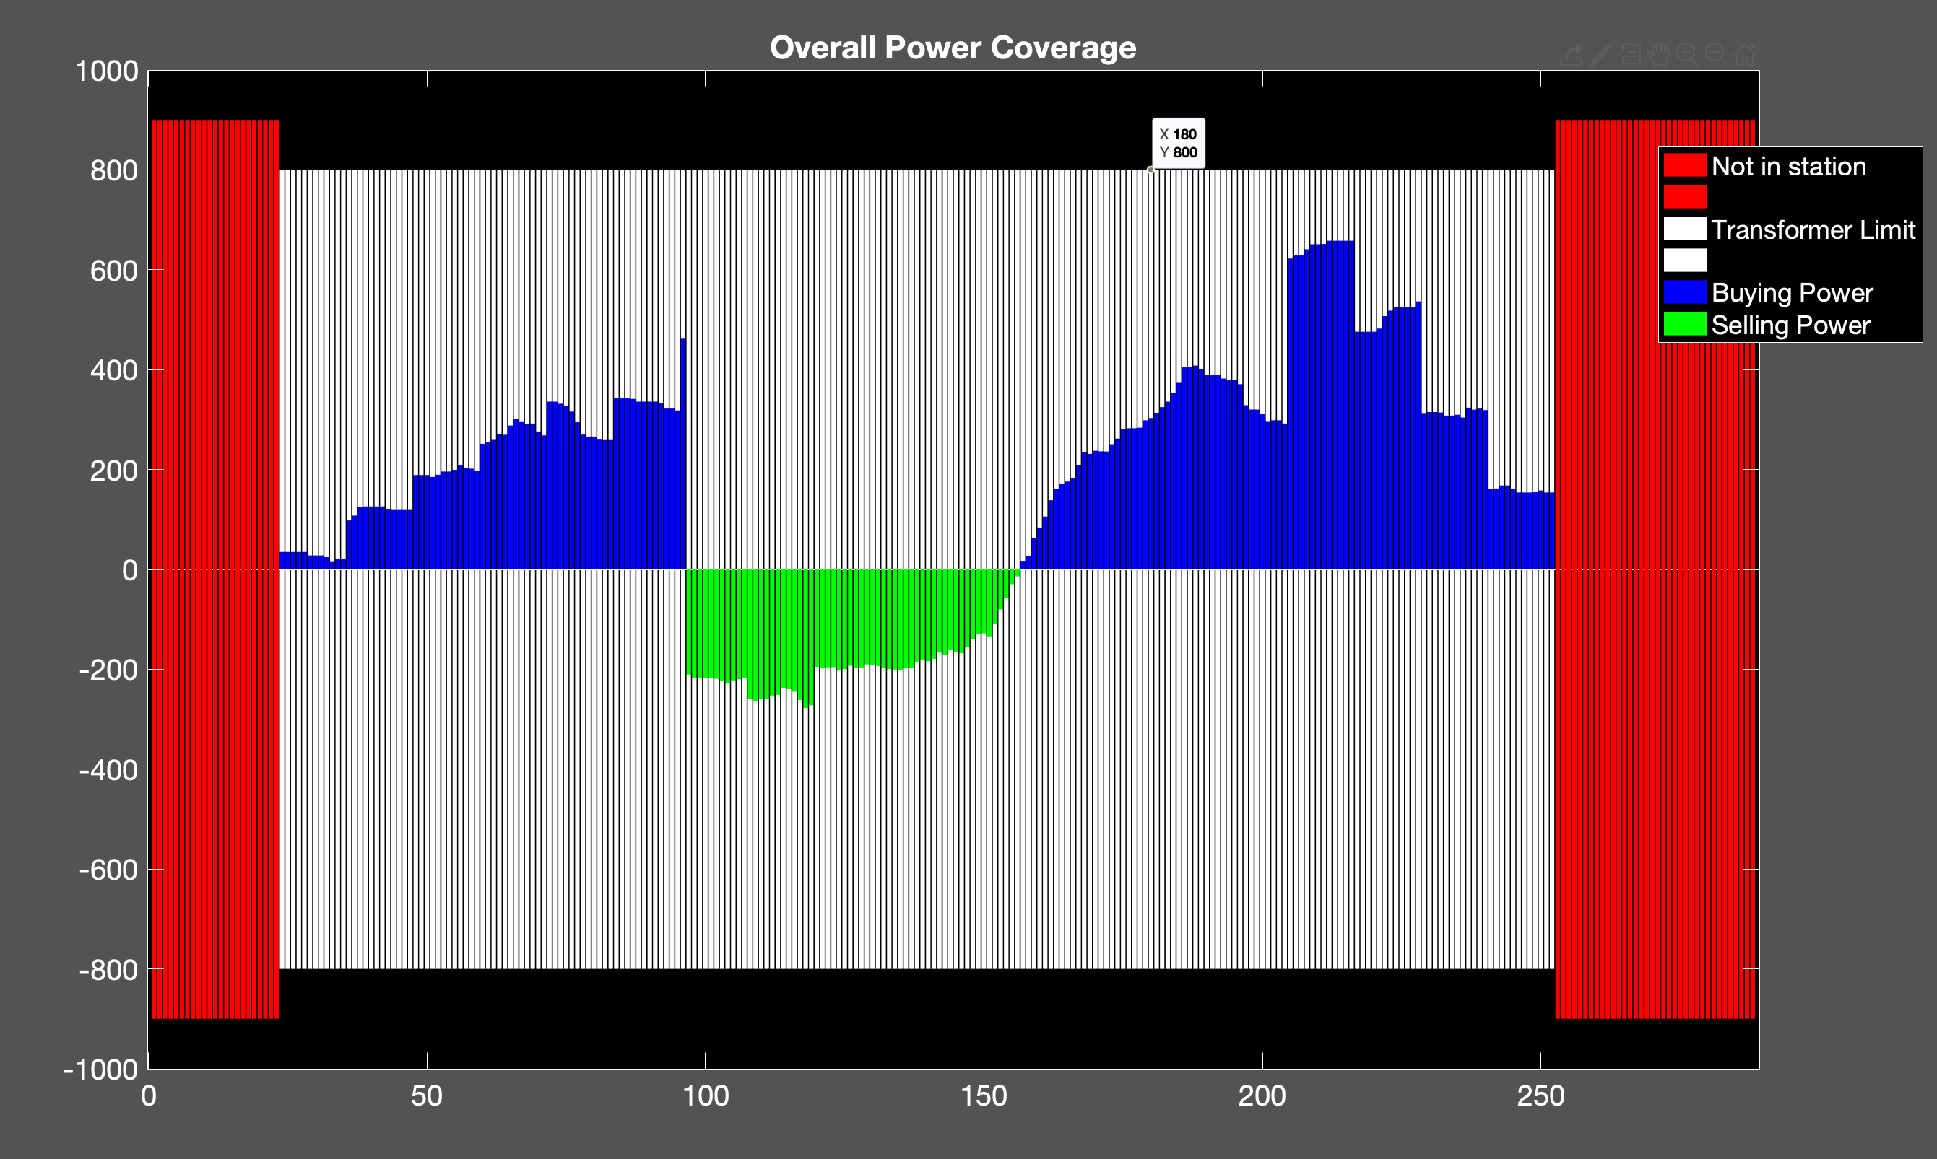
Proposed Method
150 EVs
Cost: 5.4451e+03 NT
Transformer : 800 kW

Slide 11
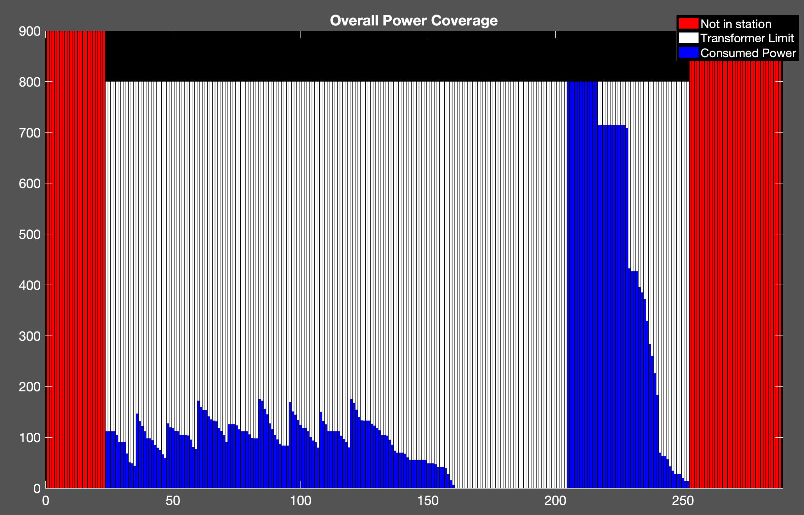
Uncoordinated Charging
150 EVs
Cost: 6.1406e+03 NT
Transformer : 800 kW

Slide 12
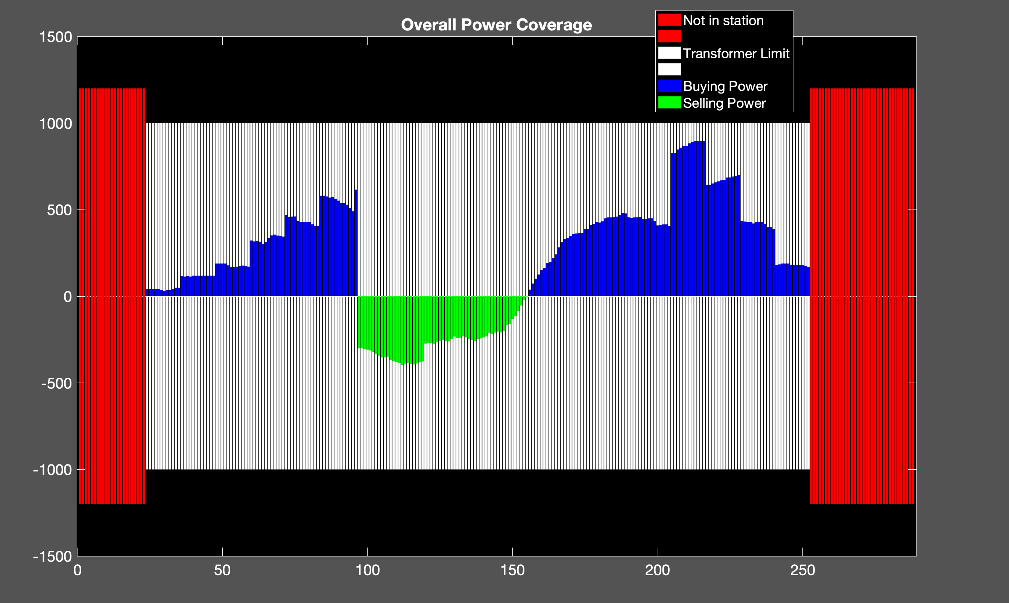
Proposed Method
200 EVs
cost: 7.1510e+03 NT
Transformer : 1000 kW

Slide 13
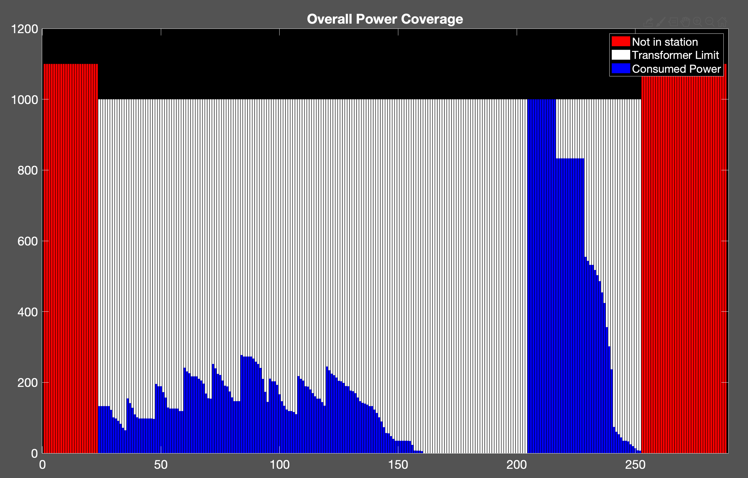
Uncoordinated Charging
200 EVs
Cost: 8.1726e+03 NT
Transformer : 1000 kW

Slide 14
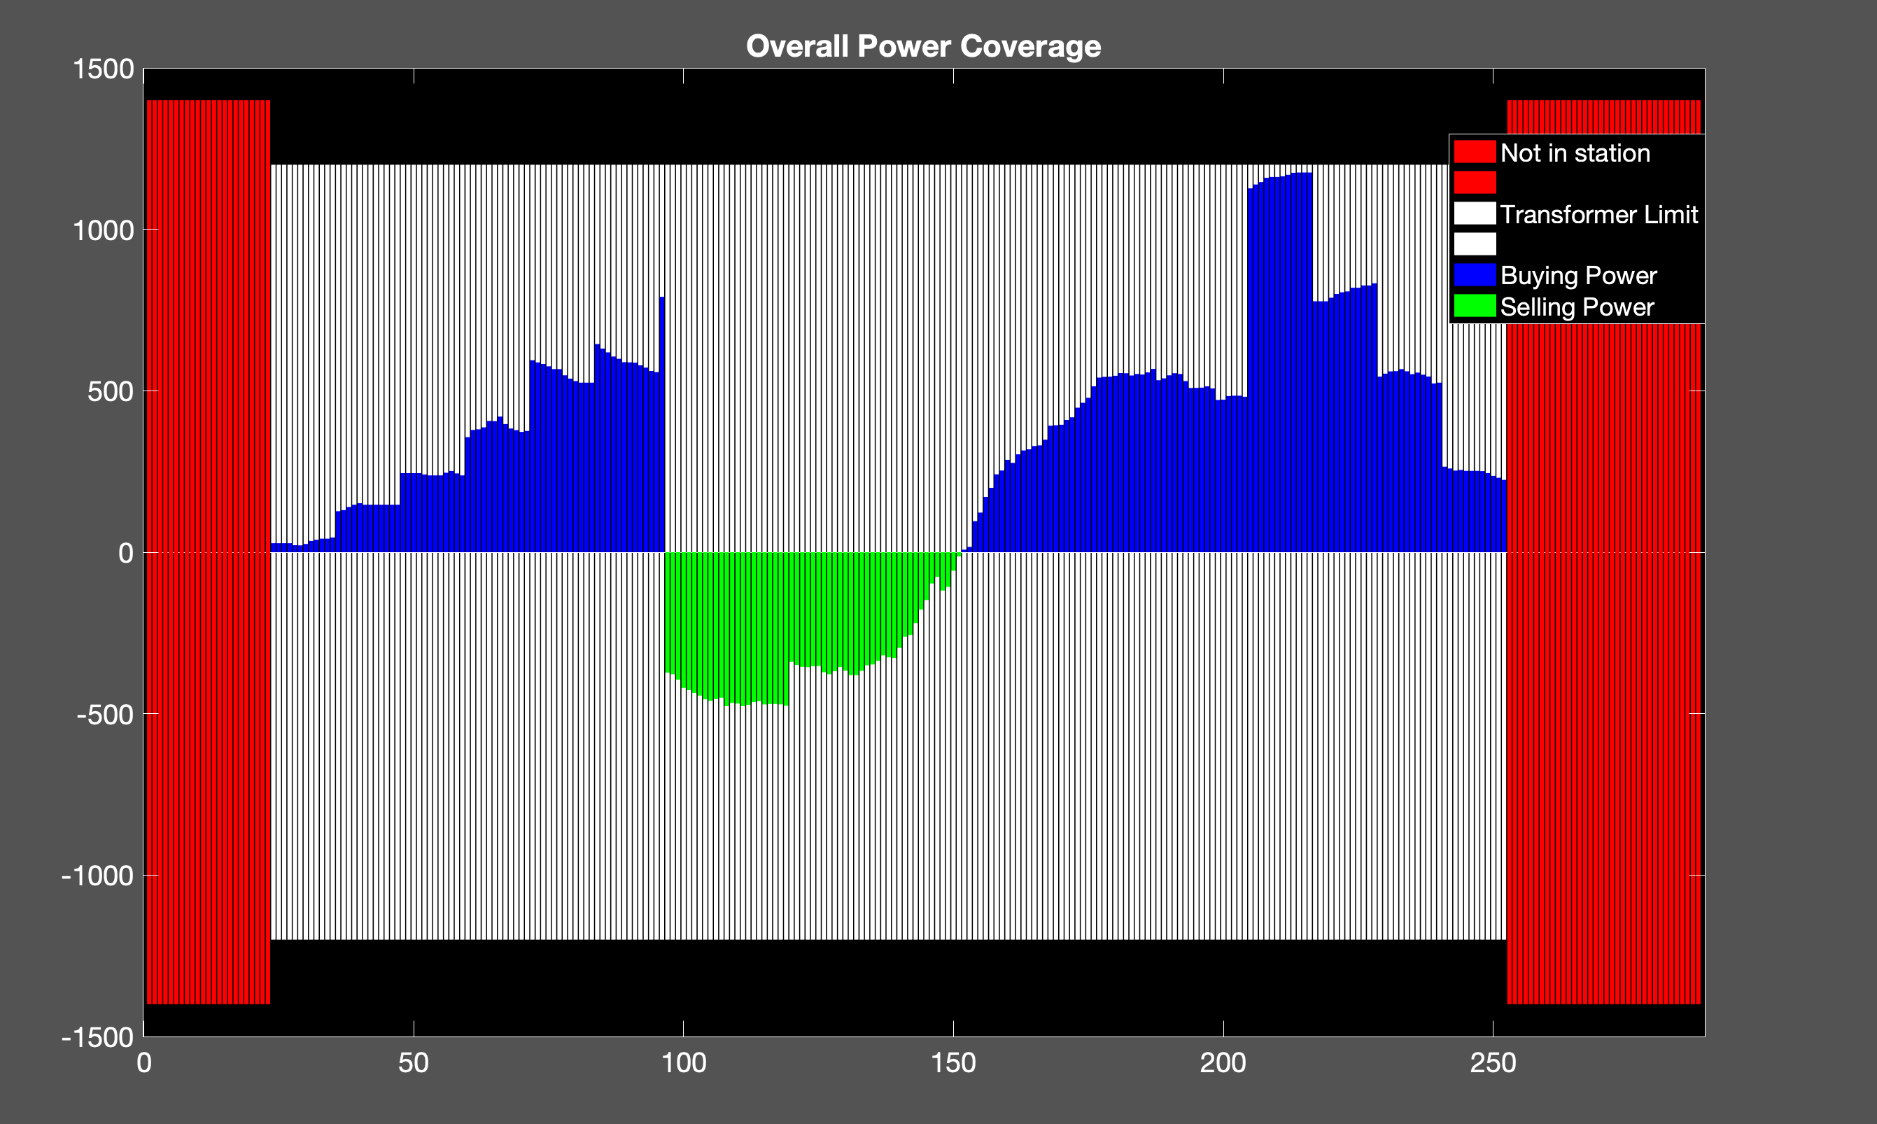
Proposed Method
250 EVs
Cost: 9.0239e+03
Transformer:1200kW

Slide 15
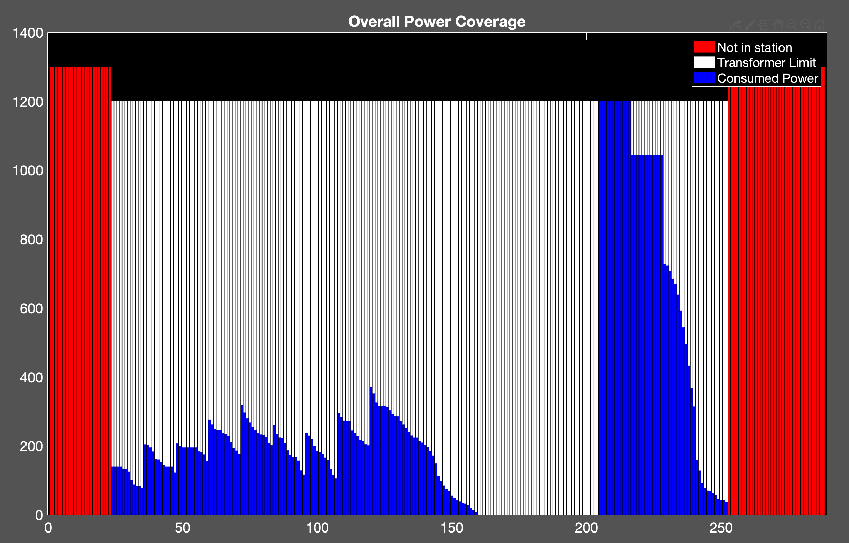
Uncoordinated Charging
250 EVs
Cost: 1.0485e+04 NT
Transformer:1200kW

Slide 16
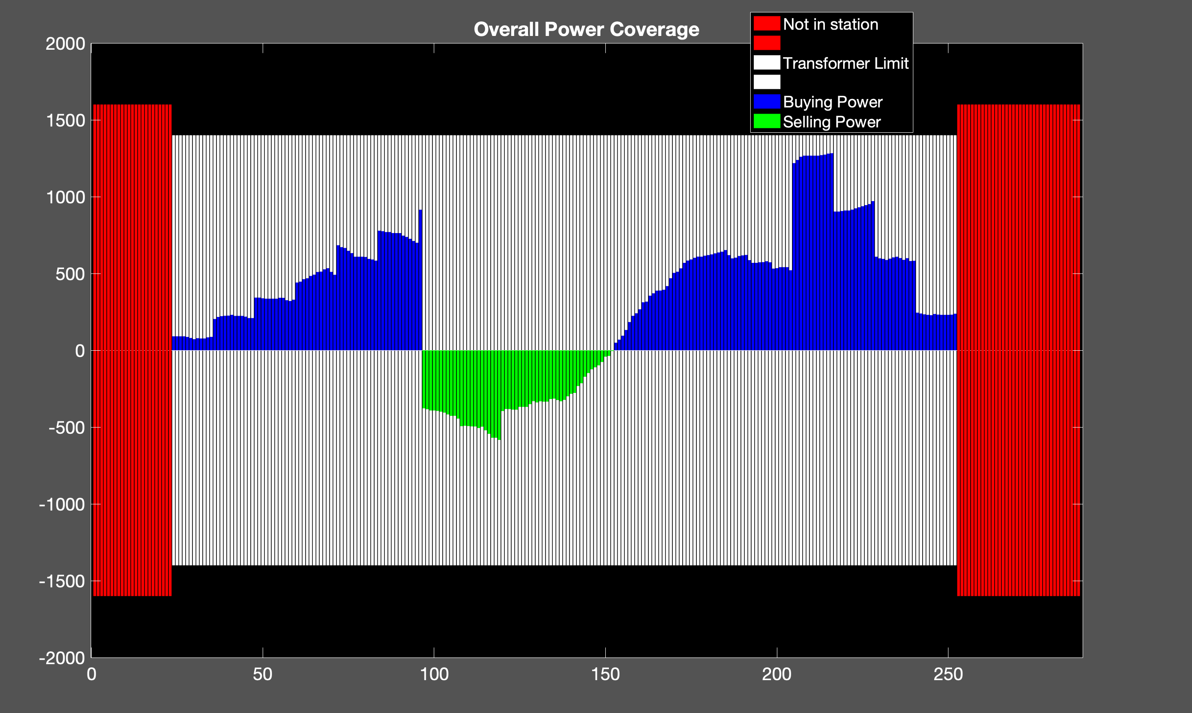
Proposed Method
300 EVs
Cost: 1.1187e+04 NT
Transformer: 1400 kW

Slide 17
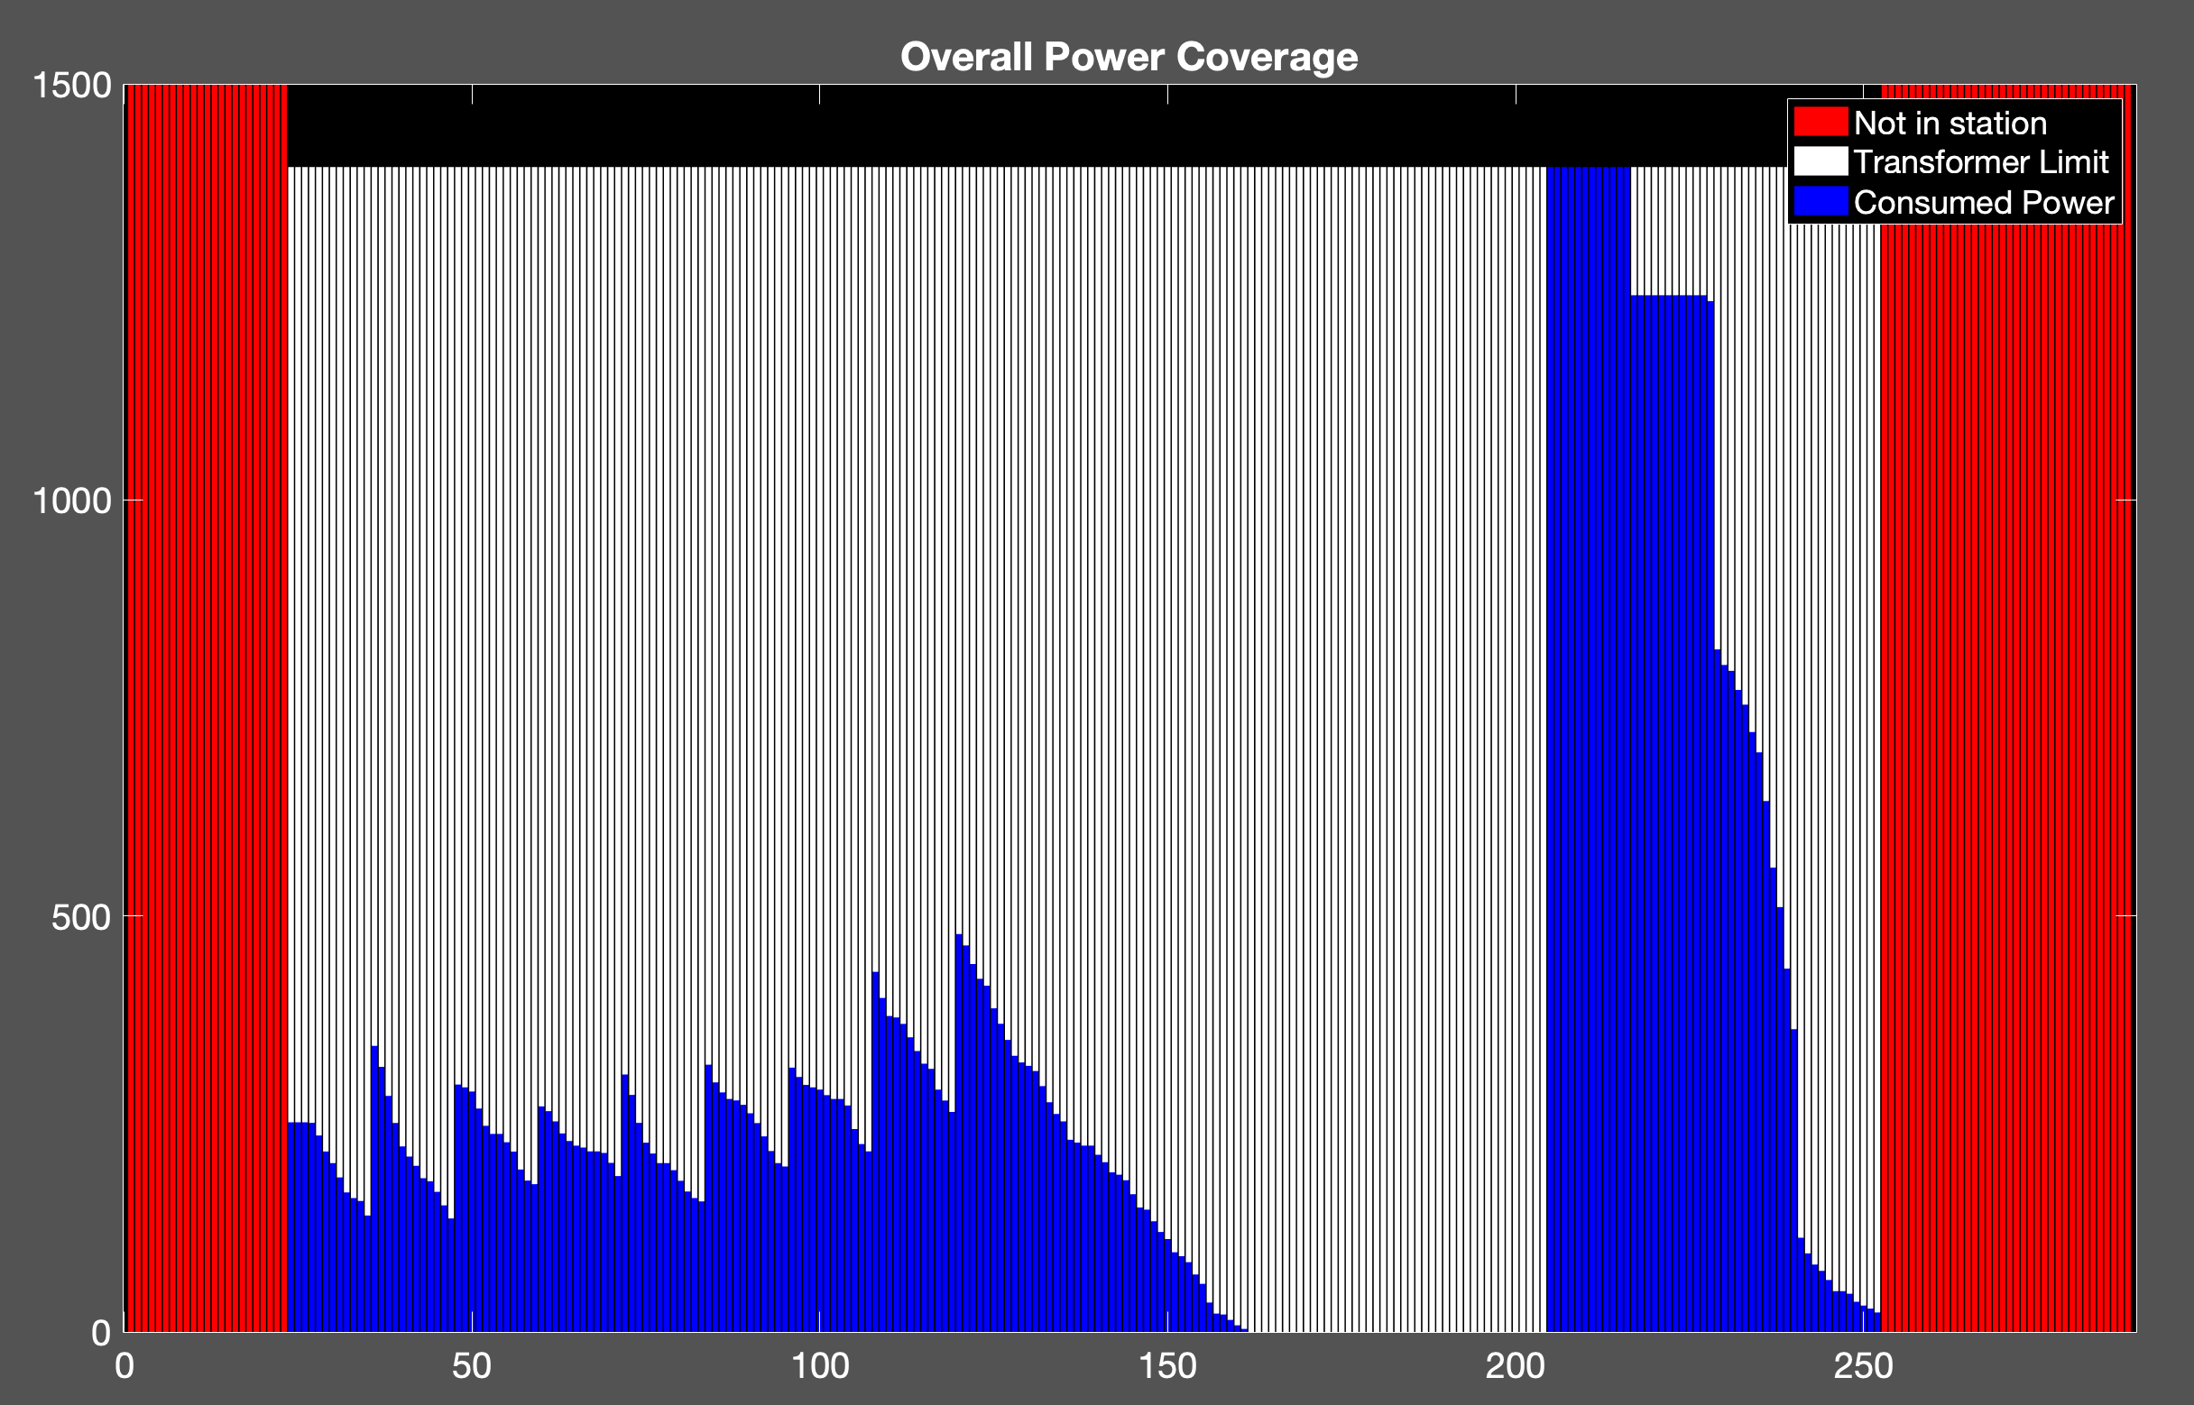
Uncoordinated Charging
300 EVs
Cost: 1.2872e+04 NT
Transformer: 1400 kW

Slide 18
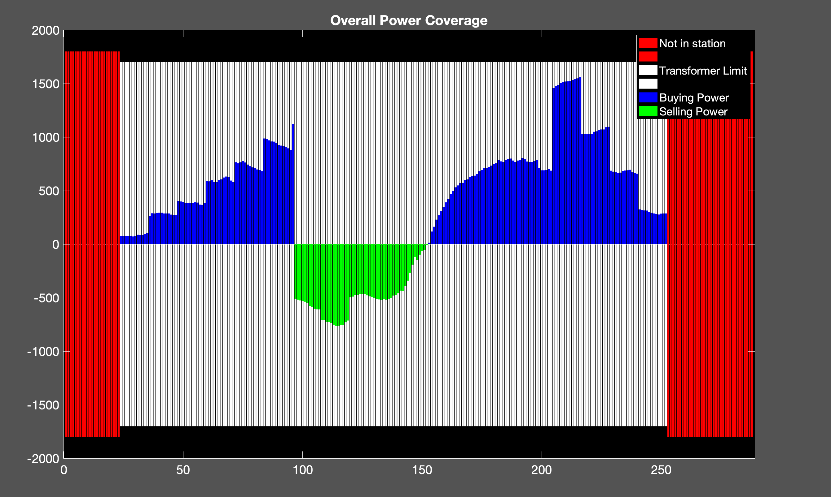
Proposed Method
350 EVs
Cost: 1.2651e+04 NT
Transformer: 1700 kW

Slide 19
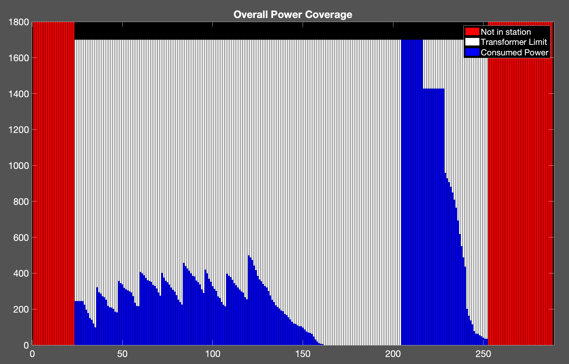
Uncoordinated Charging
350 EVs
Cost: 1.4445e+04
Transformer: 1700 kW

Slide 20
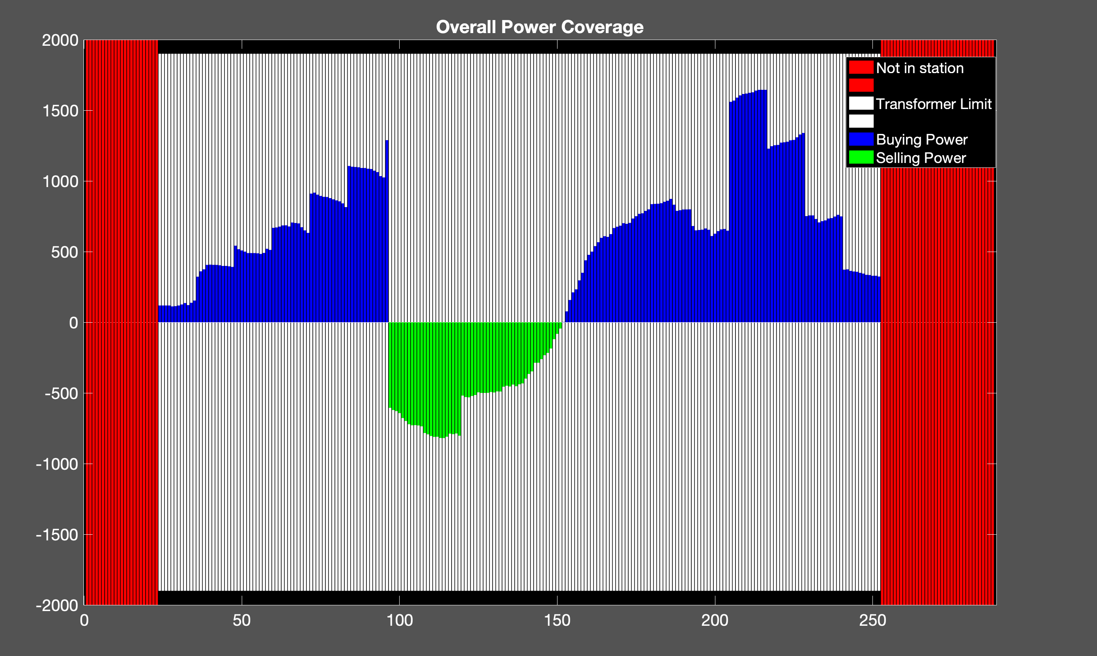
Proposed Method
400 EVs
Cost: 1.4271e+04 NT
Transformer: 1900 kW

Slide 21
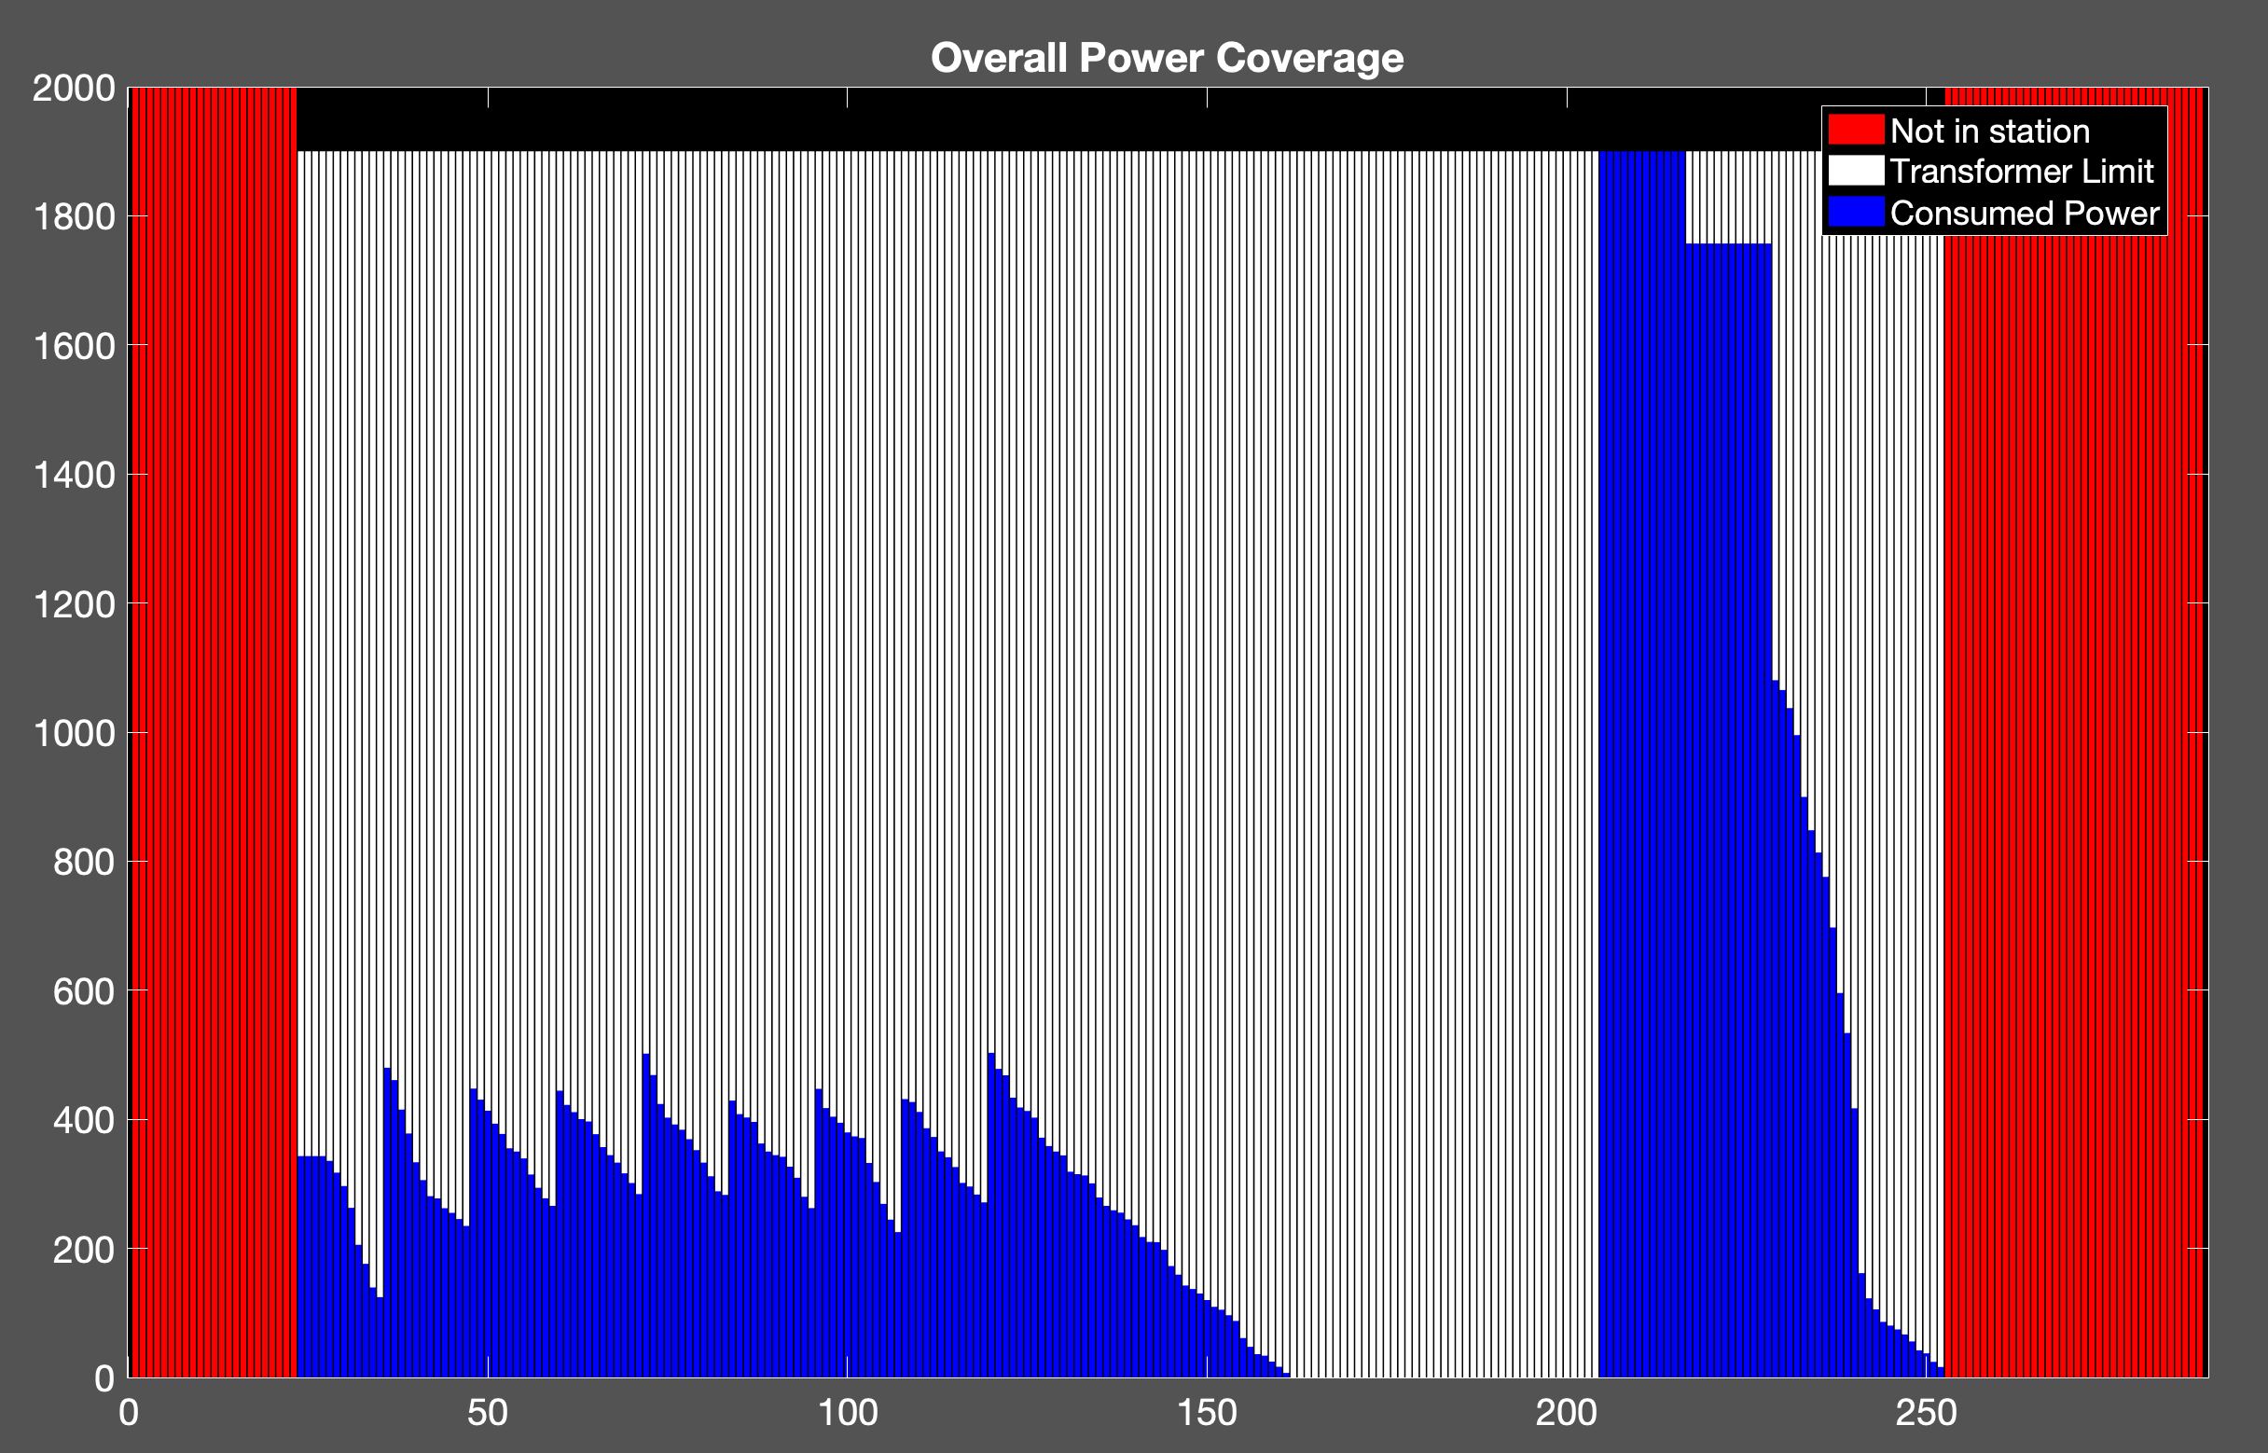
Uncoordinated Charging
400 EVs
Cost: 1.6493e+04 NT
Transformer: 1900 kW

Slide 22
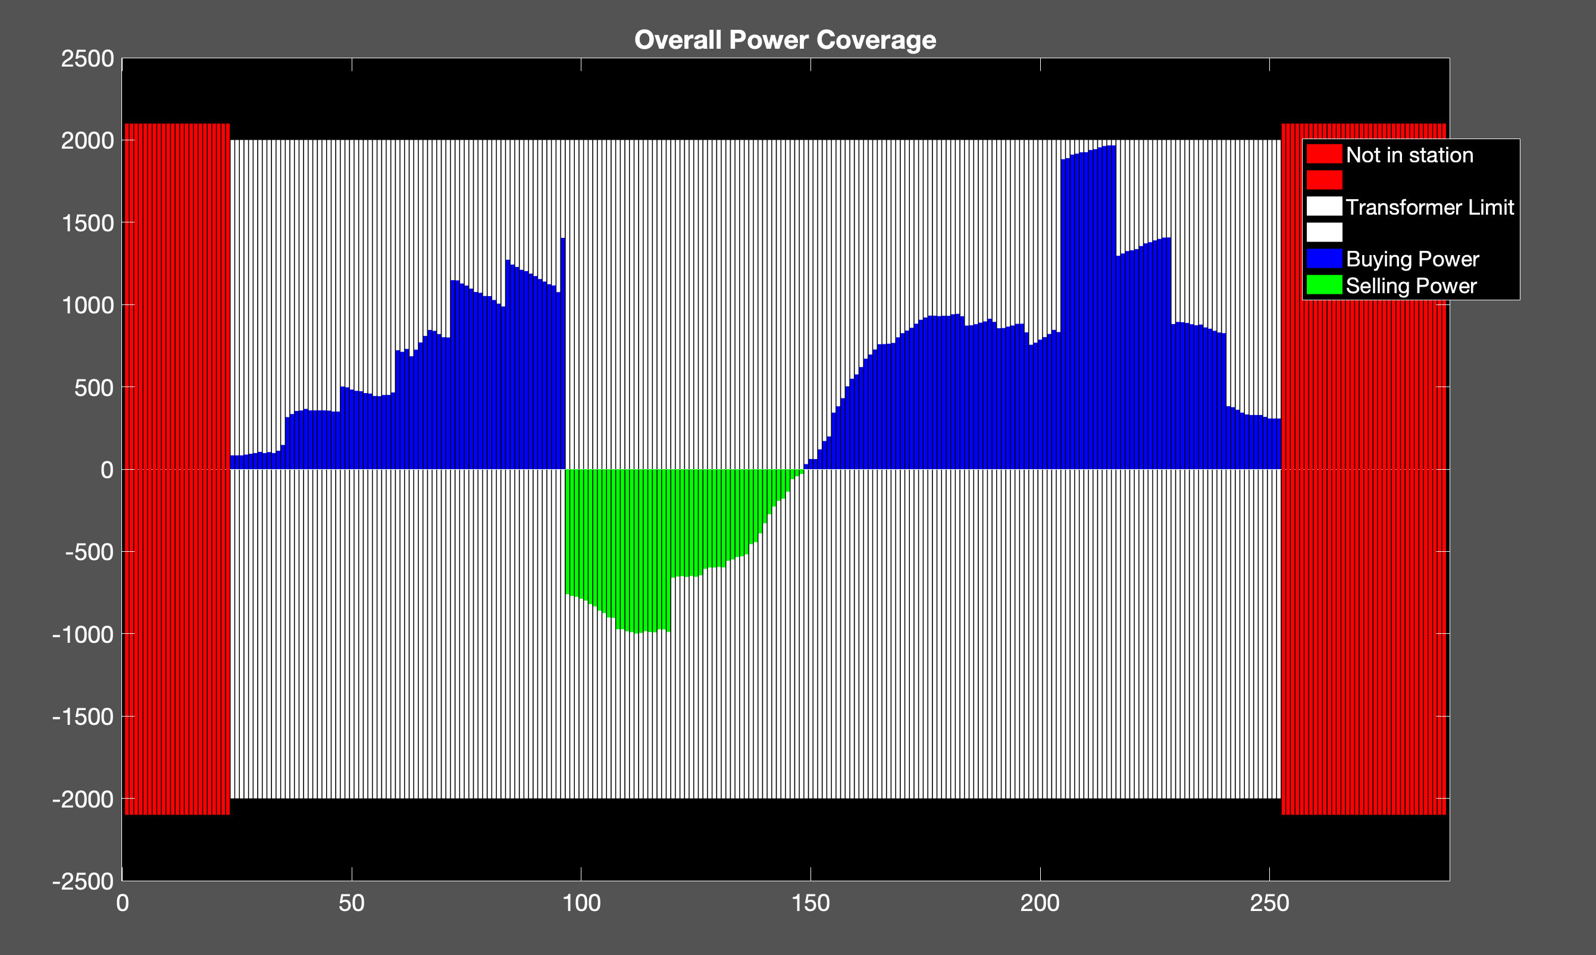
Proposed Method
450 EVs
Transformer: 2000 kW
Cost: 1.6563e+04 NT

Slide 23
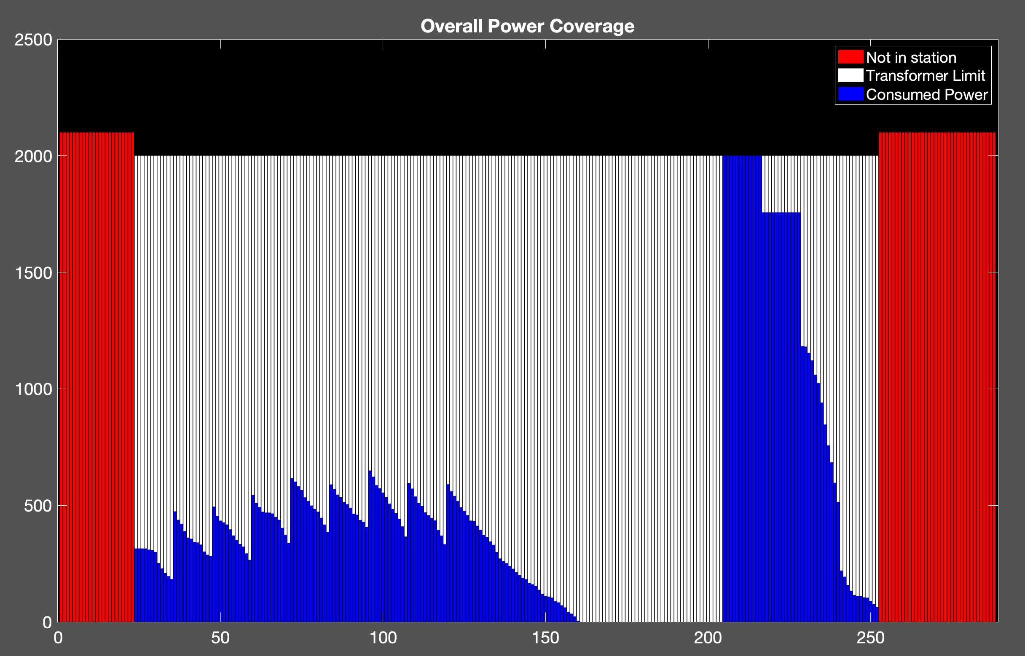
Uncoordinated Charging
450 EVs
Cost: 1.8932e+04 NT
Transformer: 2000 kW

Slide 24
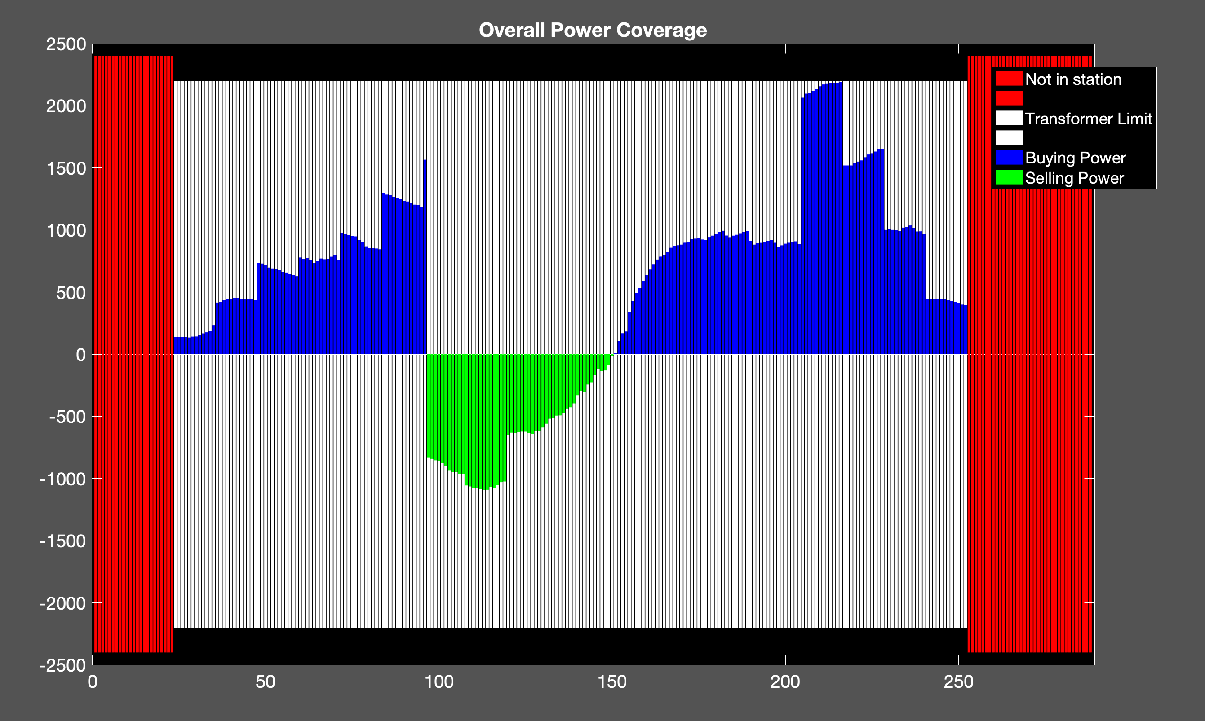
Proposed Method
500 EVs
Cost: 1.8190e+04 NT
Transformer: 2000 kW

Slide 25
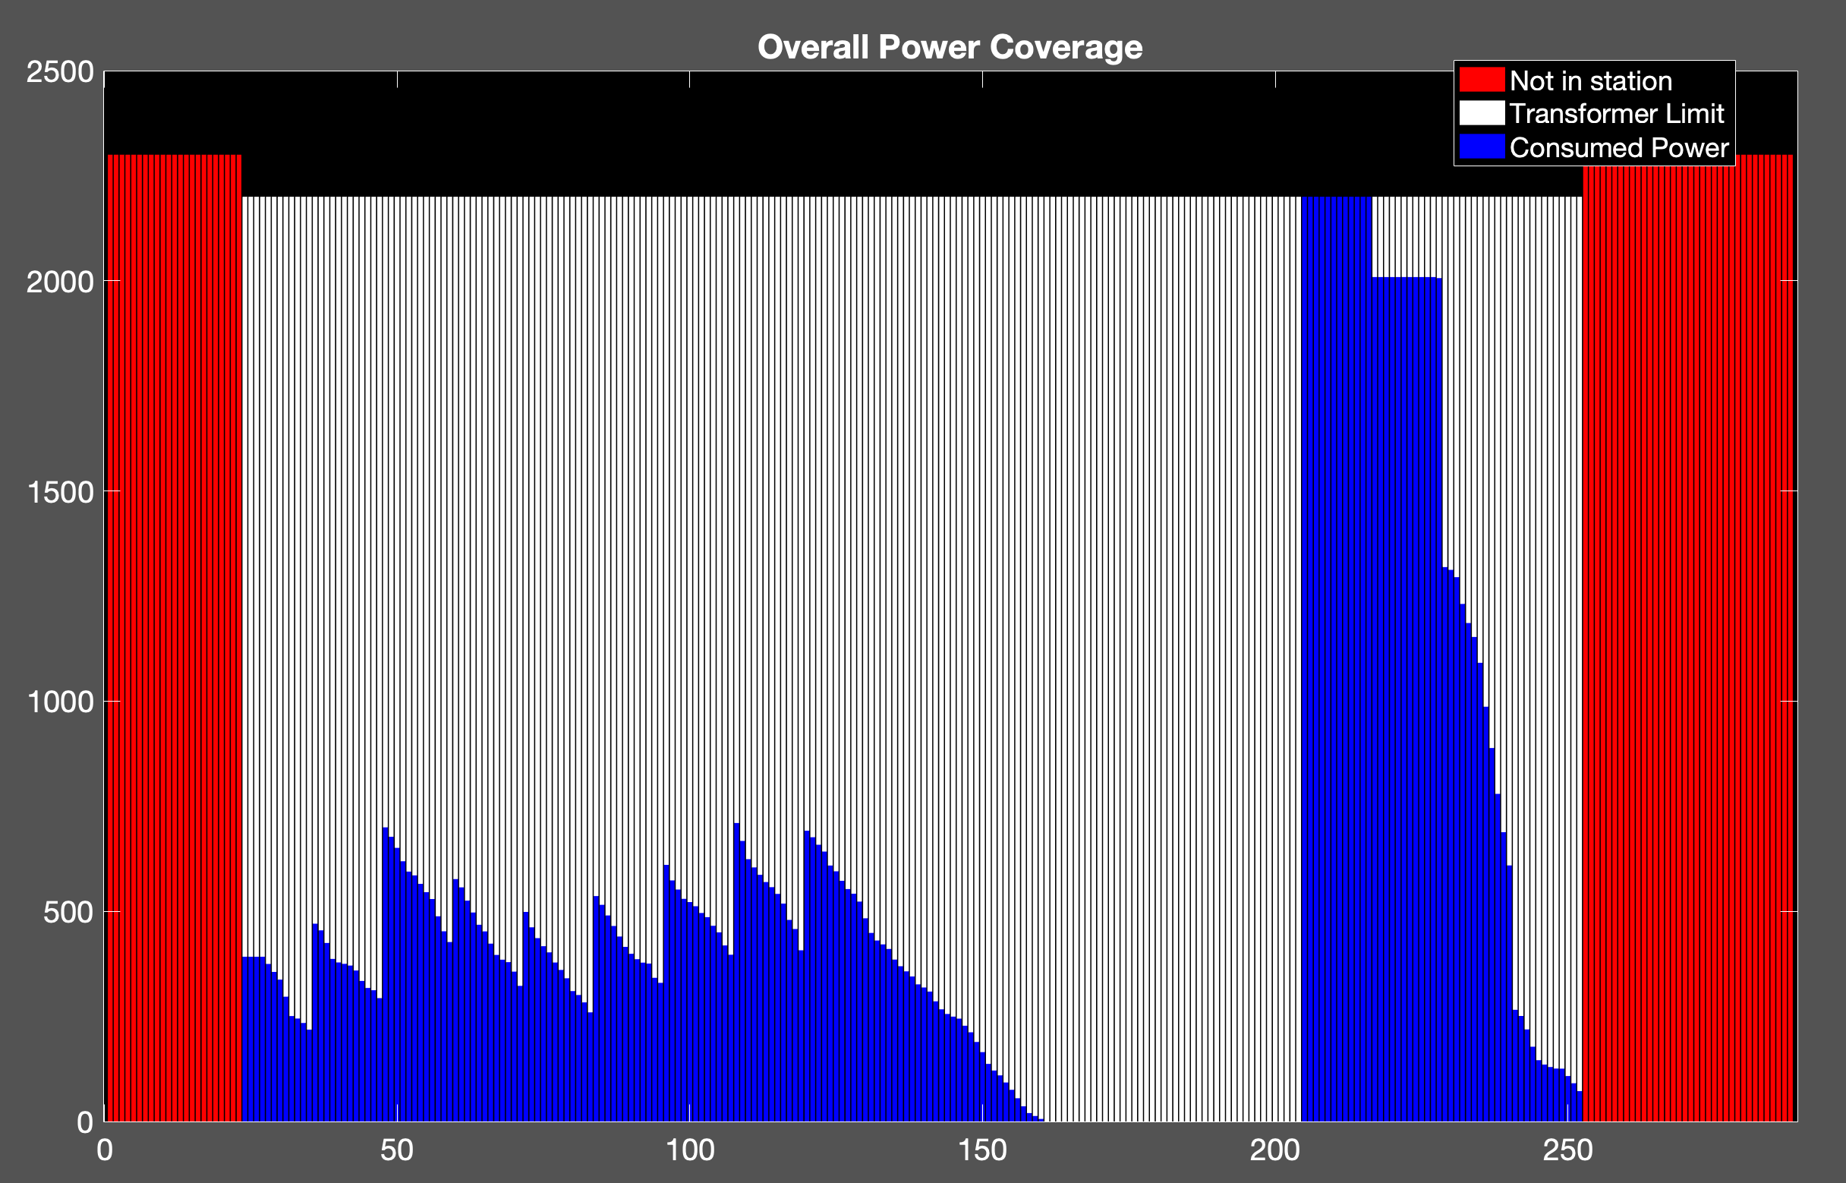
Uncoordinated Charging
500 EVs
Cost: 2.1169e+04 NT
Transformer: 2000 kW

Slide 26
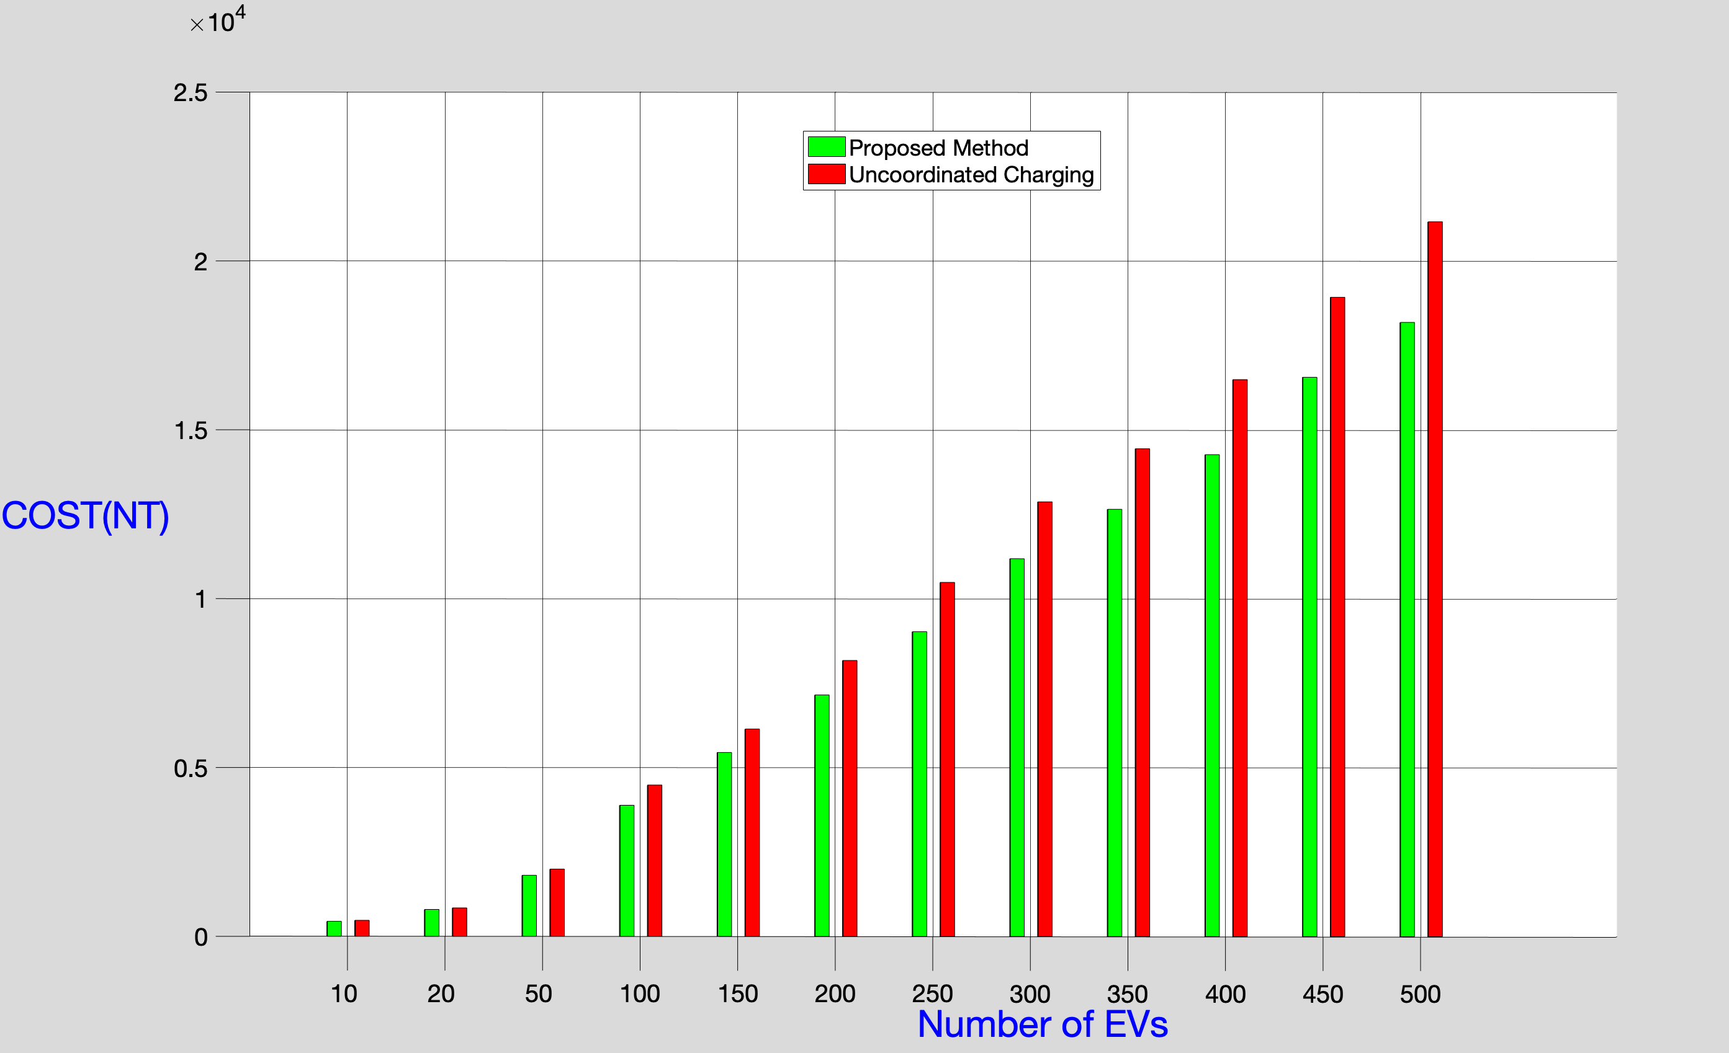
Comparative Plot

Slide 27
Interpretation
Proposed method: Distributed charging pattern
Advantage : no waiting time for new coming electrical vehicle
Uncoordinated method: grouped charging pattern
Disadvantage: long waiting time due to transformer saturation
Proposed method: low cost for large number of EVs
Uncoordinated method: relative higher charging cost
Conclusion: our method is suitable for large parking station

